Slide 1
From Pixels to Fins: Advancing Fish Detection with Machine Learning
Adam & Dorian

Slide 2
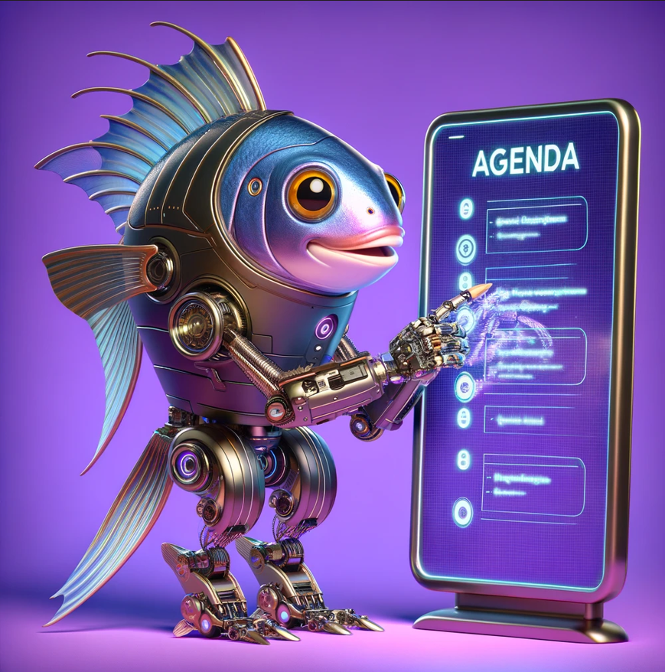
Agenda
Problem Definition
Dataset and Preparation
Baseline Models
Training and Evaluation
Deployment and Monitoring
Model Maintenance
How it works (System Architecture)
Lessons learned

Slide 3

What our project is about
Fish detection and species classification
Objective is to automate this procedure
Use of Computer Vision
Efficiency in use

Slide 4

Project Impact and Limitations
Importance & Impact
Automates ecological monitoring, conserving resources.
Accelerates research, aiding conservation efforts.
Current Solutions Limitations
Manual review: Time-intensive, not scalable.

Slide 5

ML Solution and Value
Performance & KPI
Accuracy and speed critical.
KPI: Correct classification rate & time reduction.
Why ML?
Precision: Tailors detection to specific environments.
Efficiency: Processes vast datasets swiftly.
Value Creation
Streamlines data analysis, frees resources.
Facilitates real-time monitoring, quick responses.

Slide 6
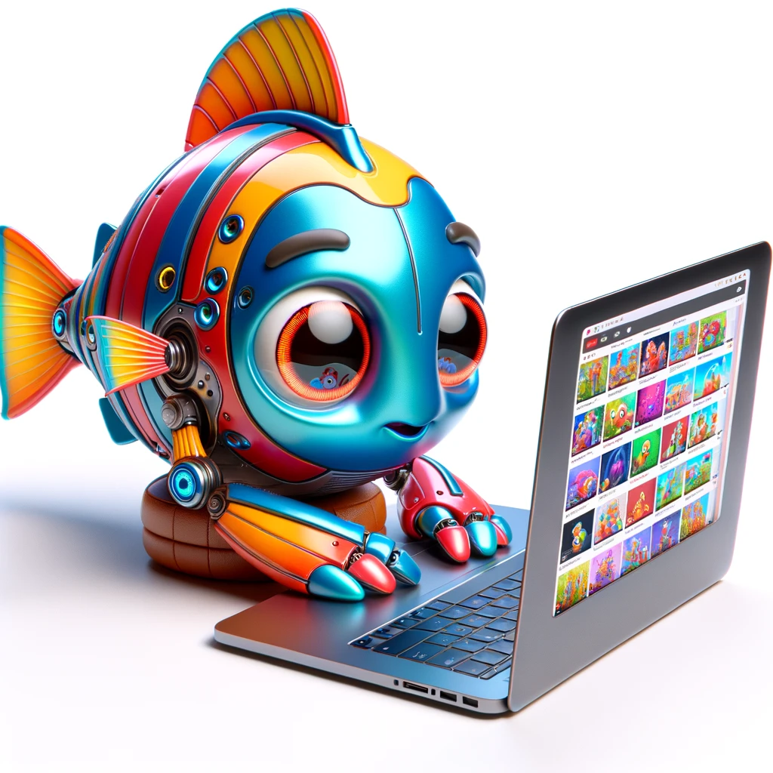
Introduction to the Dataset
The dataset is sourced from the Marine and Freshwater Research Institute in Iceland
20-second video clips captured by fish detectors in Icelandic rivers
Relevant features is classification to be able to tell if it’s fish or not
Approximately 71% of videos contain some type of fish
Potential problems is fish distribution

Slide 7
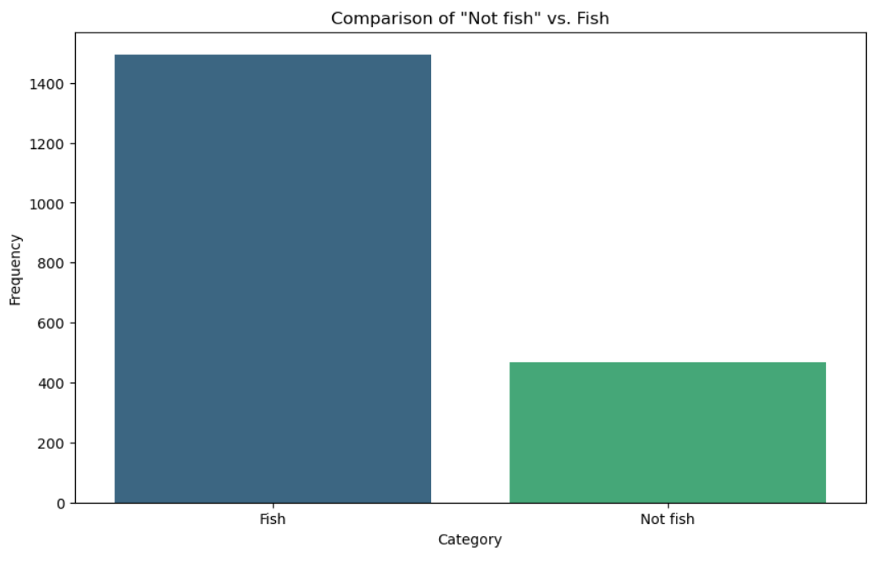
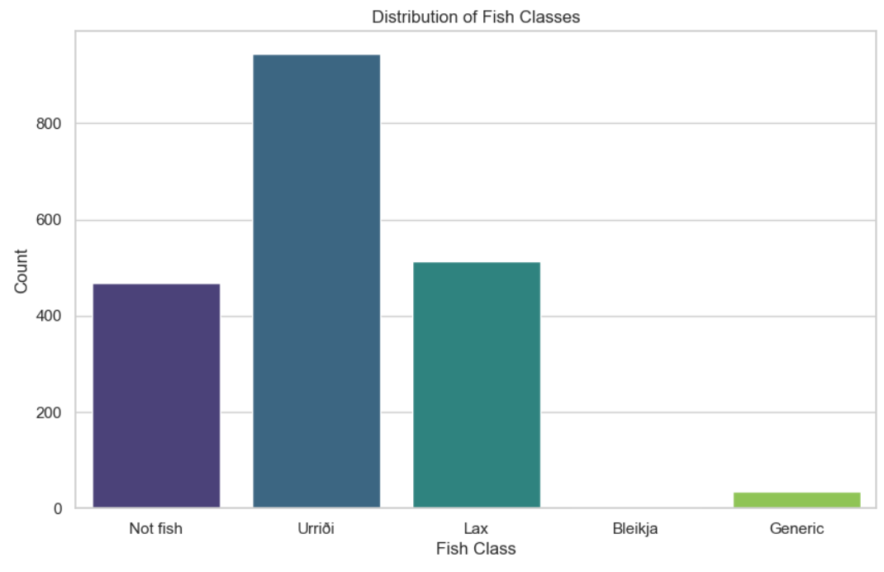
ML Task and Data Exploration
Notes:
Background Research Depth (0-5 points)

Slide 8

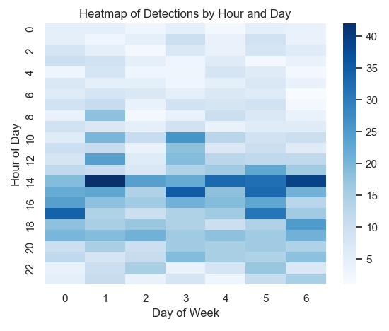

Slide 9

Preparation of Dataset
Splitting videos into frames
From approx 1961 videos
Approx 530.000 frames 640x480
MakeSense AI for manual bounding boxes creation and adjustments
Automatic bounding box creating using YOLOv5
Only one feature used

Slide 10
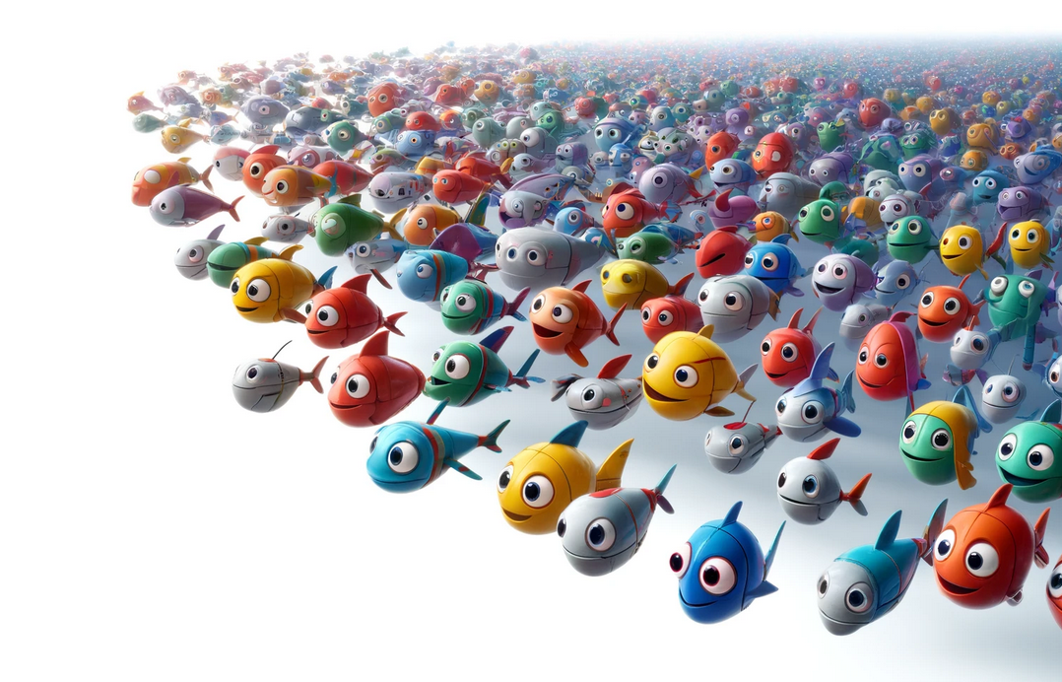
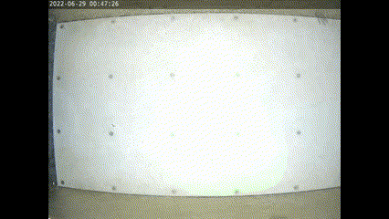


Slide 11

Performance Measurement
Performance metrics used were accuracy, precision, recall, F1 score, and AUC
Using confidence, mAP50, mAP95 scores provided by YOLO model
Testing on randomly selected videos with even distribution of fish and no fish
Notes:
Put obj seperate

Slide 12

Baseline Model
Initial training of regular CNN network
Trained on 90 videos gives 83% accuracy score
Given amount of frames in each video is computational heavy
Using YOLO model and few-shot-learning
Much faster computation
Confidence score in video containing fish approx 50%
Notes:
Put obj seperate

Slide 13

Model Training and Evaluation
CNN network no longer in use
Primary use of YOLO v5 model
Confidence score in video containing fish approximately >85%
Efficient in real-time video processing
Notes:
Put obj seperate

Slide 14
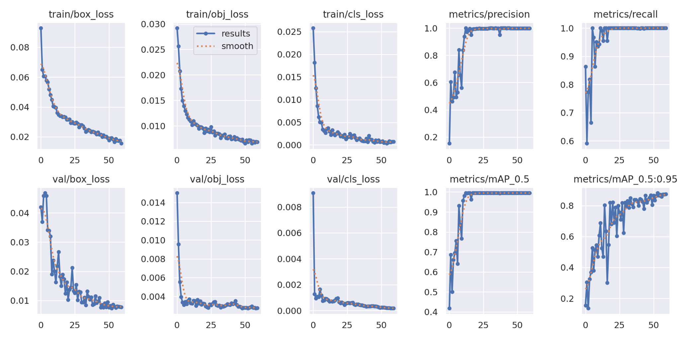

Slide 15

Further Evaluation
Initial State: Model processed full videos, even post fish detection.
Processing Time: 17-20 seconds per video.
Monthly Impact: Average processing time of 47 hours per 10,000 videos
Daily Impact: Around hour and 34 minutes per day
Notes:
Background Research Depth (0-5 points)

Slide 16
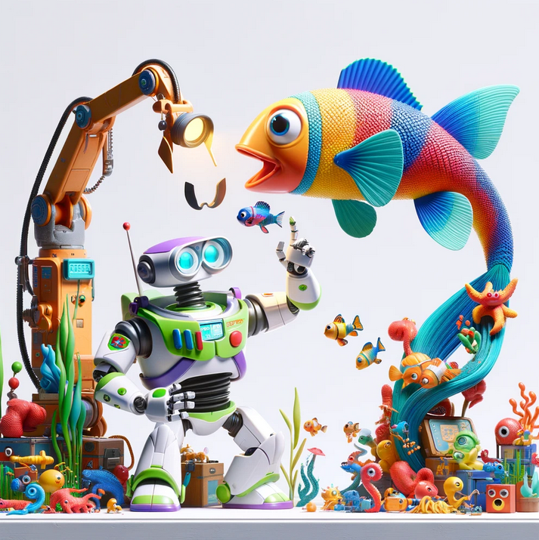
Quick Stopping
Result: Reduced processing to an average of 3.5 seconds for videos with fish.
Monthly Impact: Average processing time for 10,000 videos is 21 hours
Daily Impact: Around 42 minutes per day
Improvement of 55.59% over original implementation
Notes:
Background Research Depth (0-5 points)

Slide 17

Introduction of Nano Model
Training with the same dataset as the original model.
Processing time for videos without fish dropped to approx. 11 seconds
Monthly Impact: Average processing time of 16 hours per 10,000 videos
Daily impact: Around 32 minutes per day
Improvement of 66.18% over original implementation
Notes:
Background Research Depth (0-5 points)

Slide 18

Deployment and Monitoring
Serverless using Heroku
Preparation is key
Logging information
Logging library and txt files
Monitoring models performance
Monitor users interactions
Alerts and notifications

Slide 19

Maintenance and improvements
Anomaly detection: Down-sample video and look for changes in the pixels
Frame Skipping: Potential to bypass frames to enhance efficiency.
Fish would have to swim 13m/s to not be caught if we look at every third frame
Performance: Initial tests indicate a 10x improvement.
Data Integrity: Recall drops slightly
Next Steps: Explore advanced methods for further enhancements.
Notes:
Background Research Depth (0-5 points)

Slide 20
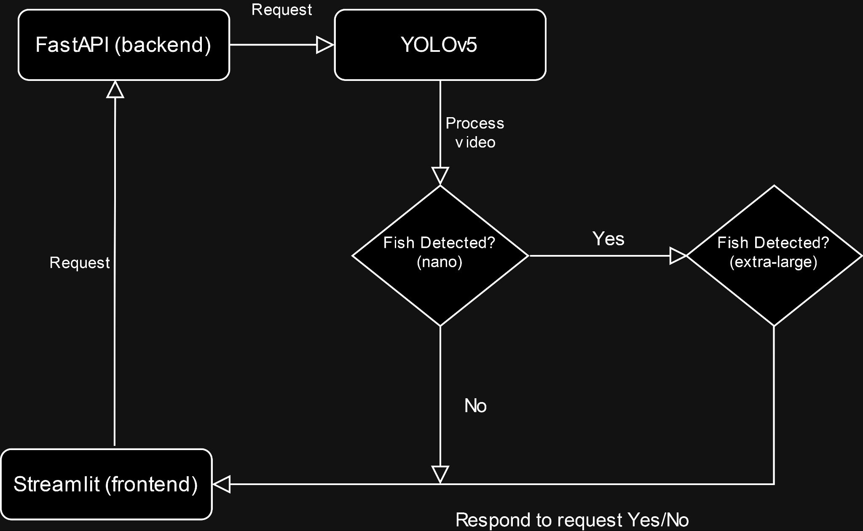
Notes:
Background Research Depth (0-5 points)

Slide 21
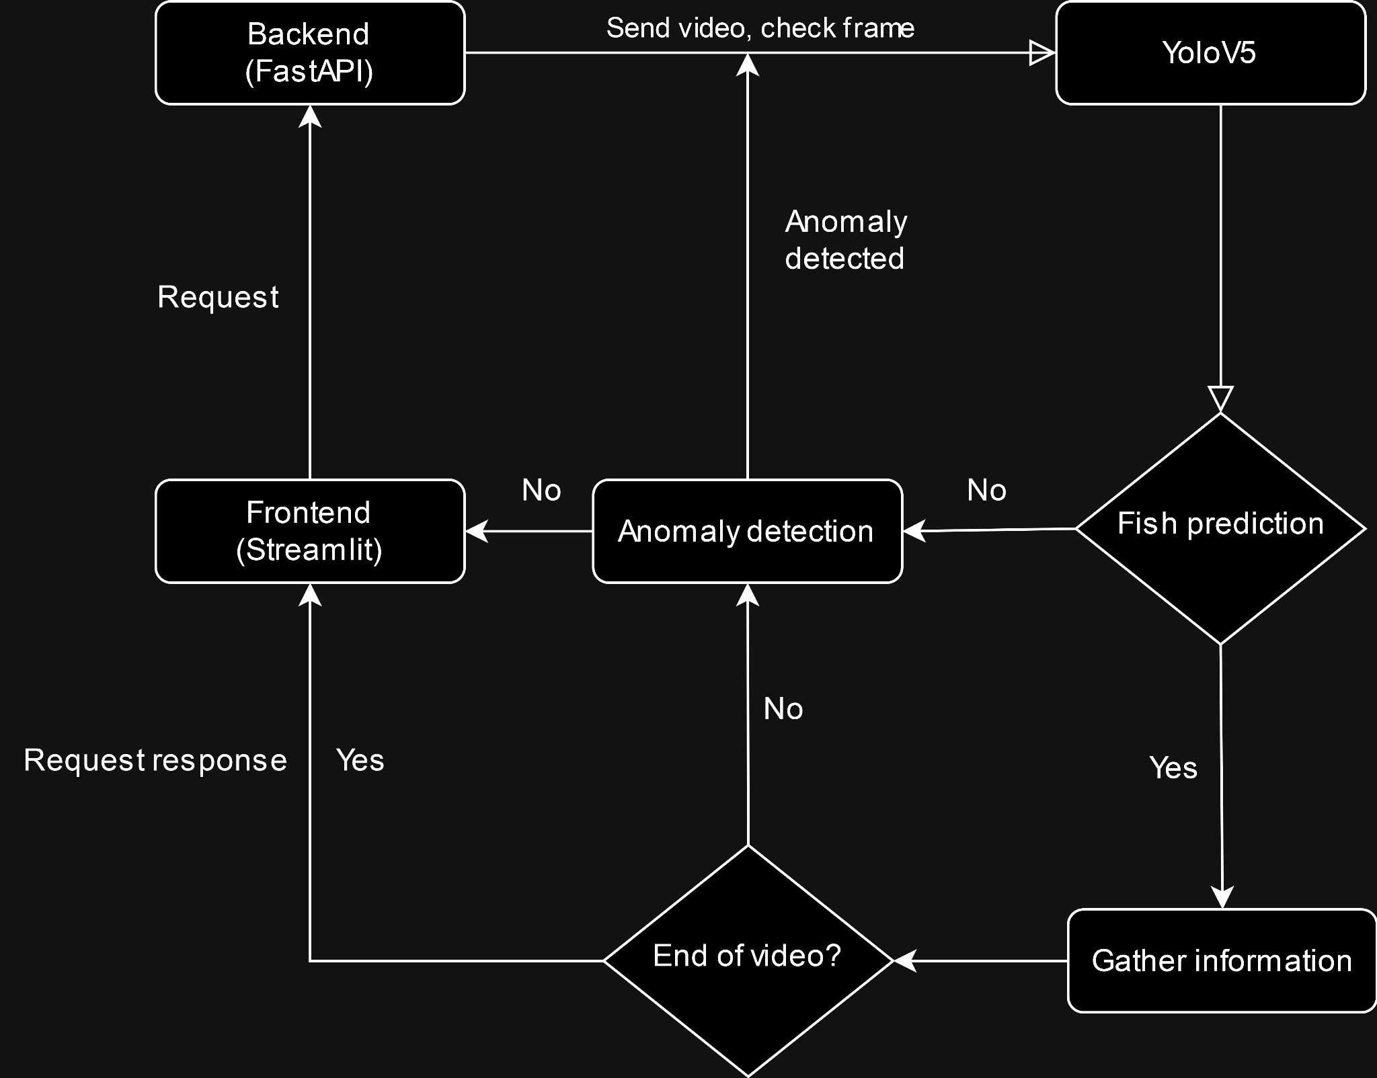
Notes:
Background Research Depth (0-5 points)

Slide 22

Spot the Difference: YOLOv5, YOLOv8 & YOLOv9 in the Wild!
YOLOv5
Ease of use
YOLOv8
Faster than v5
Higher Recall score
YOLOv9
Faster than v8
Lower Recall than v8
Higher Precision than v8
Notes:
Background Research Depth (0-5 points)

Slide 23
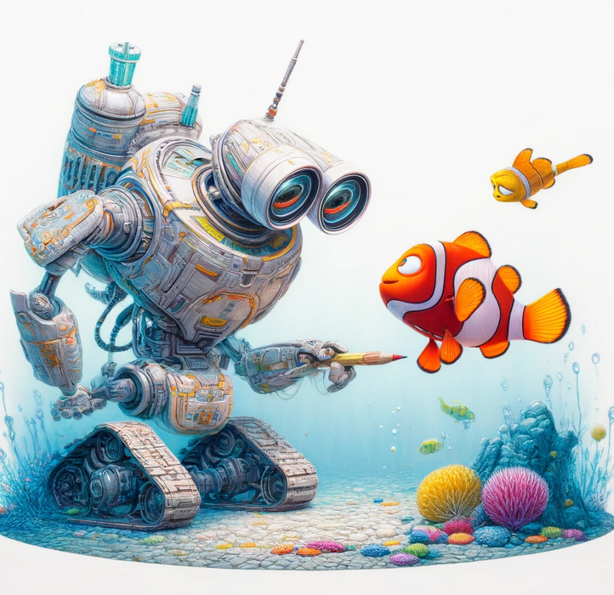
HAFRÓ and Us
Automatic Updates with New Data
Implement periodic retraining schedules
Collecting Labeled Data
User feedback mechanism for correction and verification
Partnerships with HAFRÓ for data sharing
Notes:
Background Research Depth (0-5 points)

Slide 24
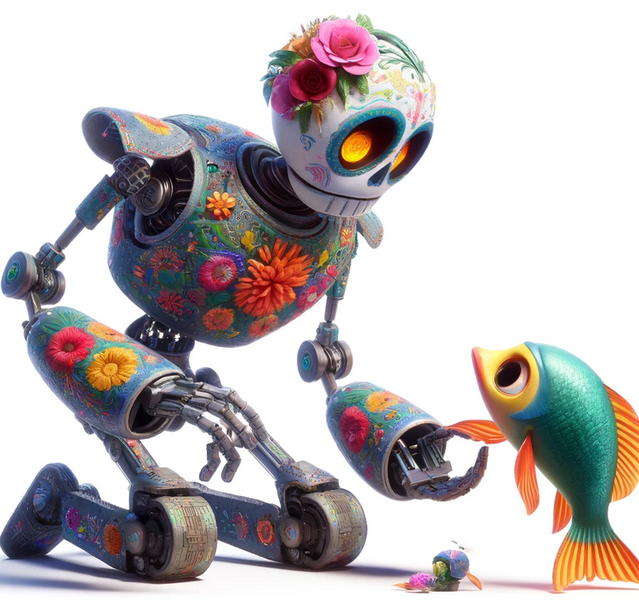
Continues Learning and Improvement
Enabling Continuous Learning
Model assisted labeling with YOLOv8.
Automated data augmentation techniques.
Post-Deployment Improvement
Monitor model performance metrics in real-time.
Leverage A/B testing to evaluate model updates.
Notes:
Background Research Depth (0-5 points)

Slide 25

Lessons learned
Experience in model deployment from development to production
Improved presentation skills to varied audiences
Advanced research skills in both qualitative and quantitative analysis
Preparation is key
Less is sometimes more
Notes:
Background Research Depth (0-5 points)

